Slide 1


DESIGN 1
Lesson 4: Formative: Abu Dhabi Grand Prix Table
Ms. Abboud • Grade 9 - Design 1 • Term 1, Week 8

Slide 2
Learning Objectives
WALT - We Are Learning To
WILF - What I'm Looking For
Build a correctly structured table from given data, on your own.
I create structured tables.
I organize data accurately.
I display information clearly.

Slide 3
Frayer Model: Table Header (Review)
DEFINITION
CHARACTERISTICS
The <th> tag: a cell used for column or row titles, shown bold and centered by default.
The <th> tag; bold/centered by default; used for column/row titles.
TABLE HEADER
EXAMPLES
NON-EXAMPLES
<th>Grand Prix</th> at the top of the Famous Grand Prix table.
<td> (a regular data cell).

Slide 4
National Identity Integration
UAE Statistical Information: the UAE publishes official data in clear tables so people can compare facts quickly. This week your F1 website presents real data, including facts about the Abu Dhabi Grand Prix.

Slide 5
STARTER
Spot the Bug
One row of a table has only 1 <td> but the others have 2.
What will the table look like? How do you fix it?
Hook • Engage & Ask
5 - 10 minutes

Slide 6
LESSON CORE
I Do: The Formative Task
Build the Abu Dhabi Grand Prix facts table on Vision and Mission, under 'Celebrate the Abu Dhabi GP'.
Then go through every check on the Final Checklist (Tables).
Gradual Release of Responsibility
30 - 40 minutes
1 / 3

Slide 7
LESSON CORE
We Do: Stuck? Use the Example
Ask for the Example Code sheet and compare one line at a time.
Peer check all four of your tables.
Gradual Release of Responsibility
30 - 40 minutes
2 / 3

Slide 8
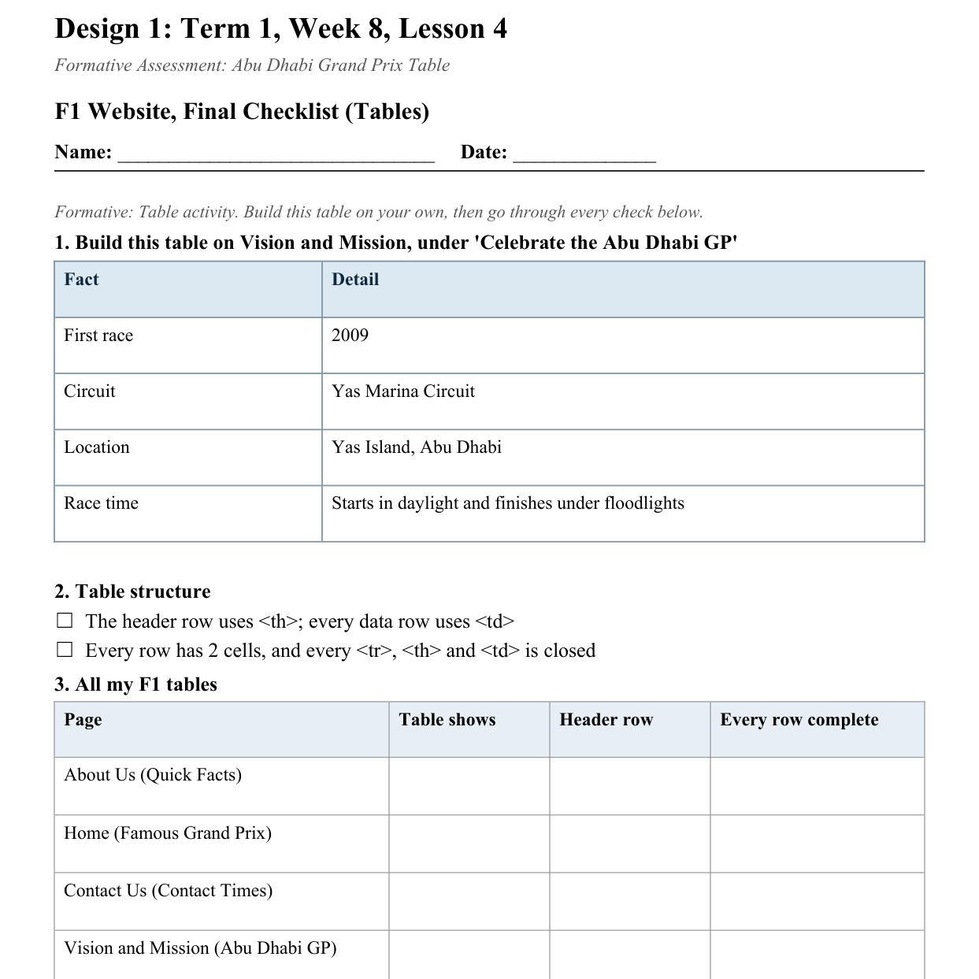
LESSON CORE
You Do: Build, Check, Submit
Build the table, tick every check, then submit via Toddle.
Activity: F1 Website, Final Checklist (Tables)
Gradual Release of Responsibility
30 - 40 minutes
3 / 3

Slide 9
CLOSURE
Exit Ticket
Name one real website where a table would genuinely be useful.
Transition & Extend
5 - 10 minutes

